Slide 1
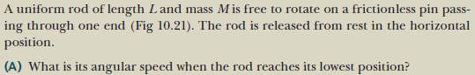
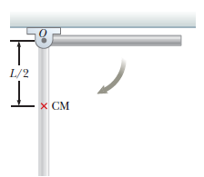
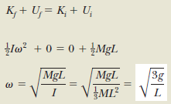
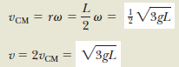

Slide 2
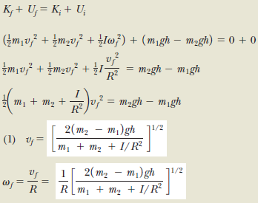
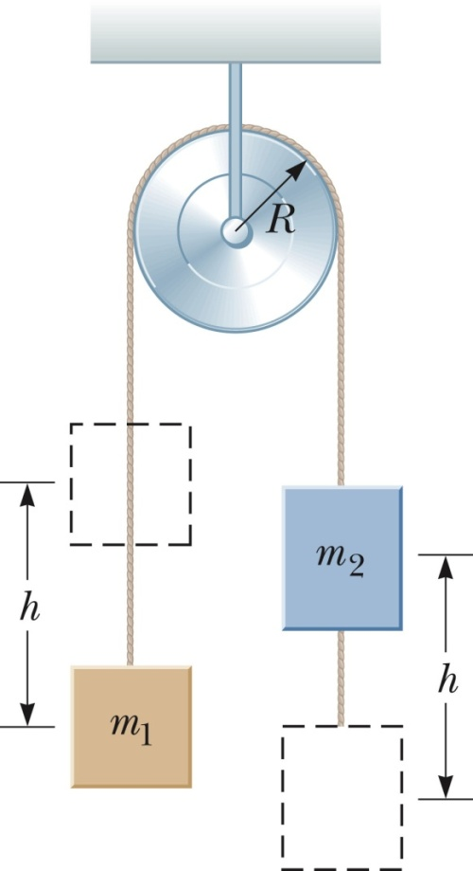

Slide 3
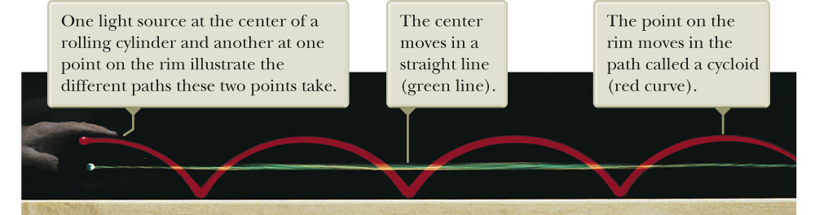
Rolling Object
The red curve shows the path moved by a point on the rim of the object.
This path is called a cycloid.
The green line shows the path of the center of mass of the object.
In pure rolling motion, an object rolls without slipping.
In such a case, there is a simple relationship between its rotational and translational motions.

Slide 4
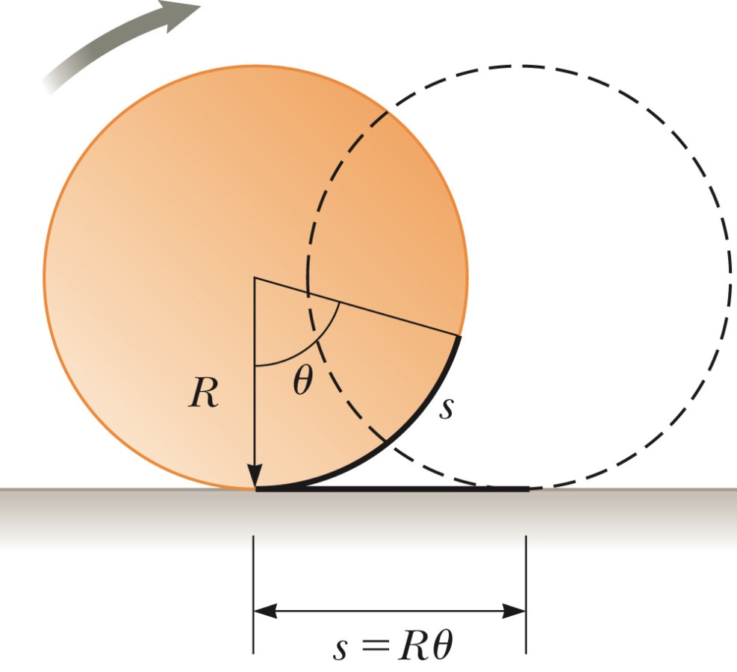
Pure Rolling Motion, Object’s Center of Mass
The translational speed of the center of mass is
The linear acceleration of the center of mass is

Slide 5
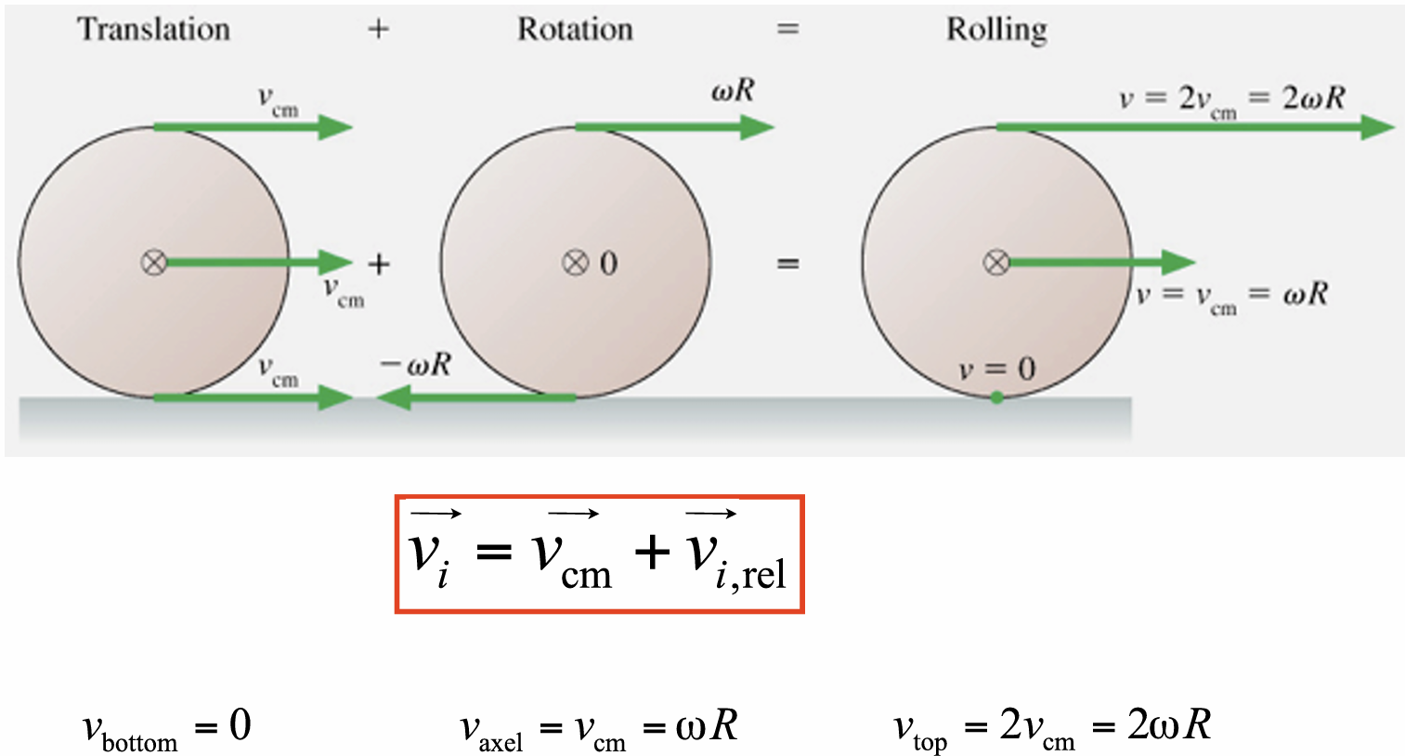
Rolling Motion Cont.
Rolling motion can be modeled as a combination of pure translational motion and pure rotational motion.
The contact point between the surface and the cylinder has a translational speed of zero (c).

Slide 6
Total Kinetic Energy of a Rolling Object
The total kinetic energy of a rolling object is the sum of the translational energy of its center of mass and the rotational kinetic energy about its center of mass.
K = ½ I_{CM} ω² + ½ Mv_{CM}²
The ½ I_{CM}ω² represents the rotational kinetic energy of the cylinder about its center of mass.
The ½ Mv² represents the translational kinetic energy of the cylinder about its center of mass.

Slide 7
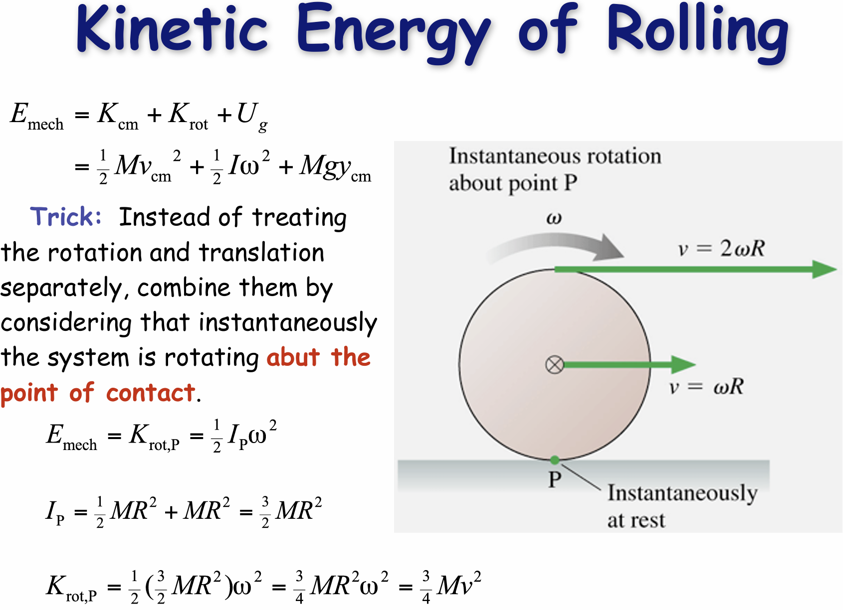

Slide 8
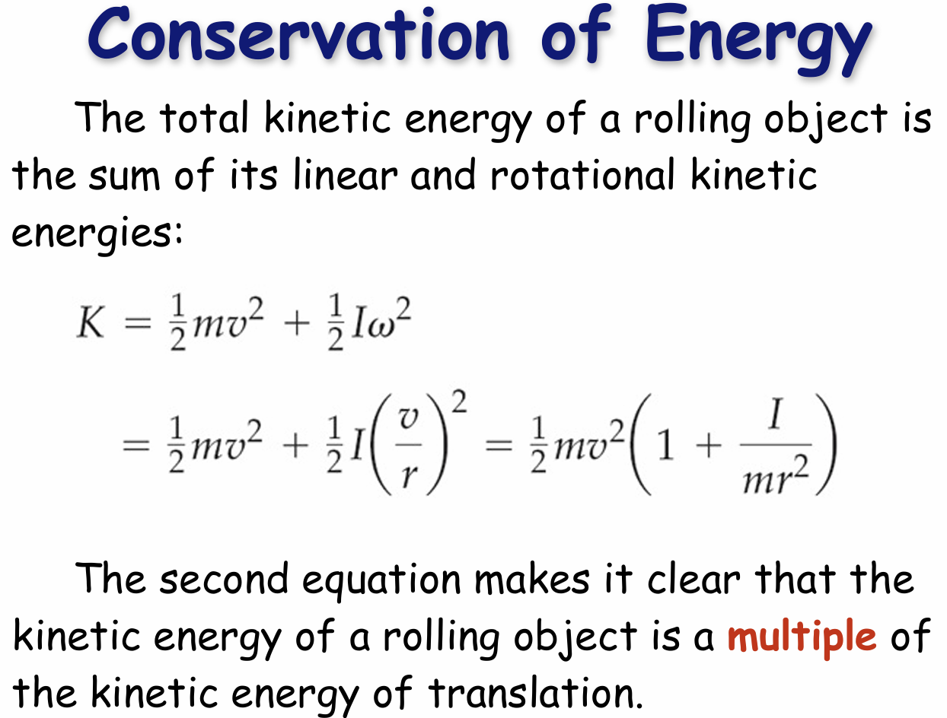

Slide 9
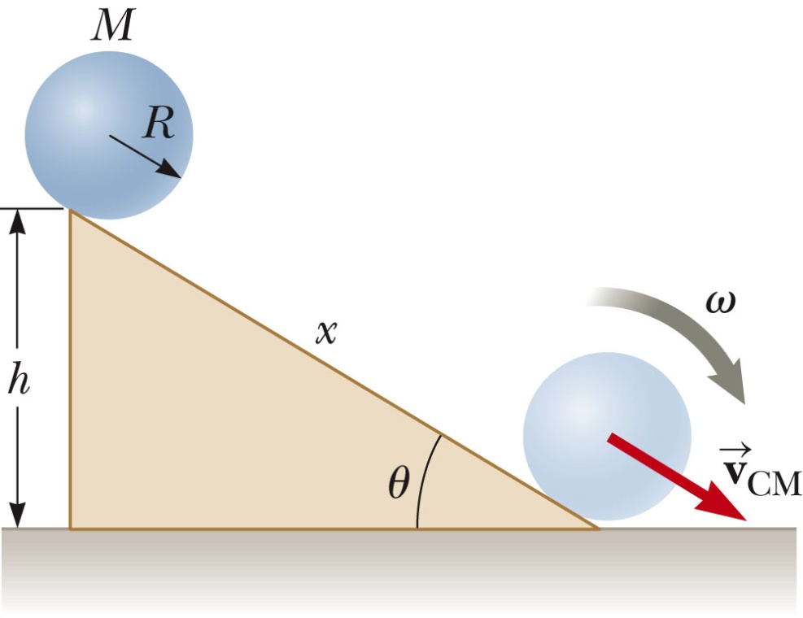
Accelerated rolling motion is possible only if friction is present between the sphere and the incline.
The friction produces the net torque required for rotation.
No loss of mechanical energy occurs because the contact point is at rest relative to the surface at any instant.
In reality, rolling friction causes mechanical energy to transform to internal energy.
Rolling friction is due to deformations of the surface and the rolling object.

Slide 10
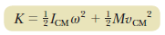

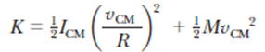
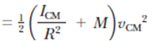
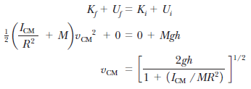
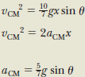
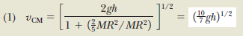

Slide 11

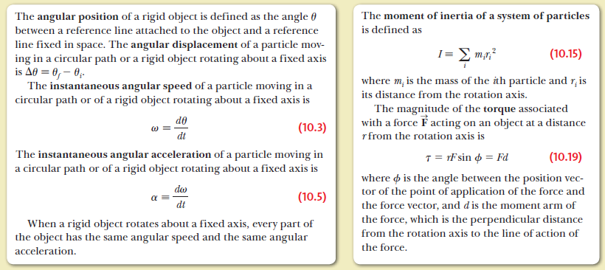
Summary

Slide 12

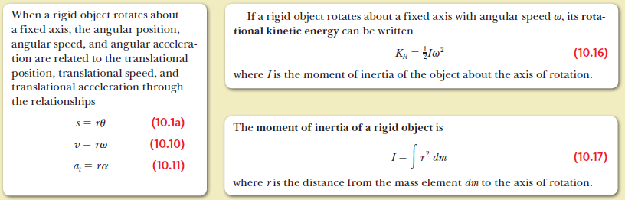
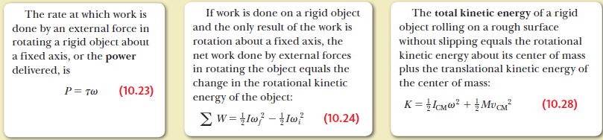
Summary

Slide 13

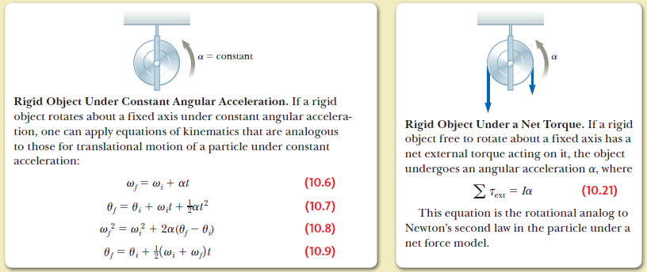
Summary

Slide 14
Intended Learning Outcomes
To apply the concept of angular momentum in isolated and non-isolated systems

Slide 15
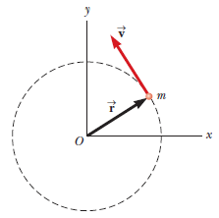
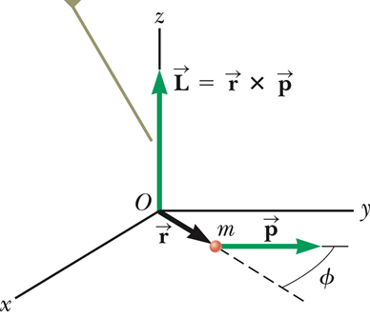
Newton’s second law in terms of angular momentum
Consider a force is applied on a particle of mass m located at the vector position for rotational motion (The force actually provides a torque on the mass for the rotation).
Adding a term to the above equation,
where is defined as the angular momentum.
The SI units of angular momentum are (kg.m²)/ s.
Both the magnitude and direction of the angular momentum depend on the choice of origin.

Slide 16
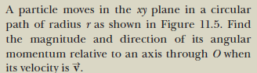
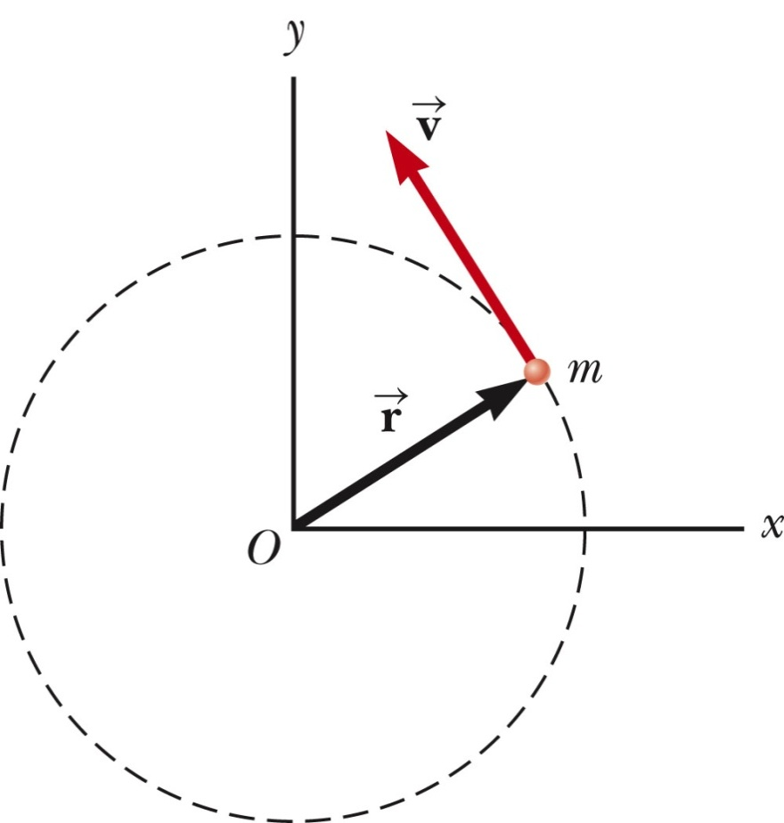
The vector is pointed out of the diagram.
The magnitude is L = rp sin 90º = mvr
sin 90º is used since v is perpendicular to r.
A particle in uniform circular motion has a constant angular momentum about an axis through the center of its path.

Slide 17
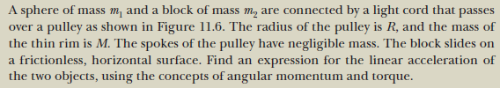
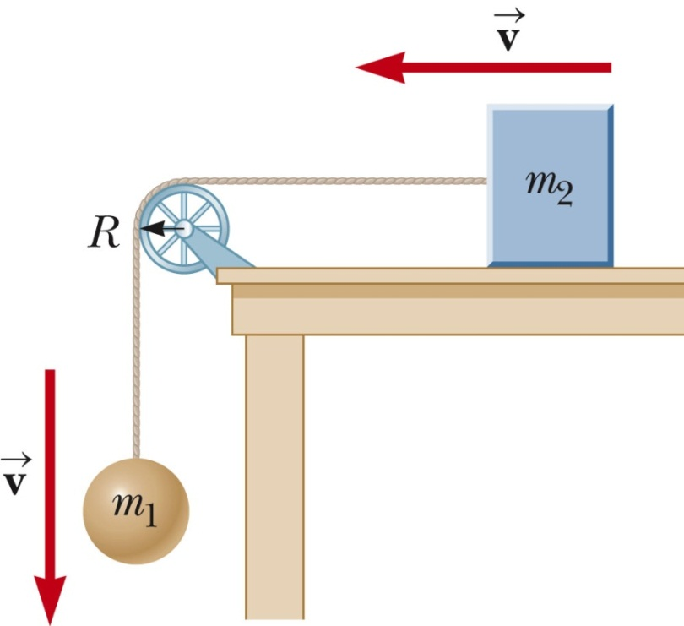
1. Using the torque-angular momentum approach:

Slide 18
2. Using the torque-angular acceleration approach:
For m₁:
For pulley:
For m₂:
T₂
T₂
T₁
T₁
m₁g

Slide 19
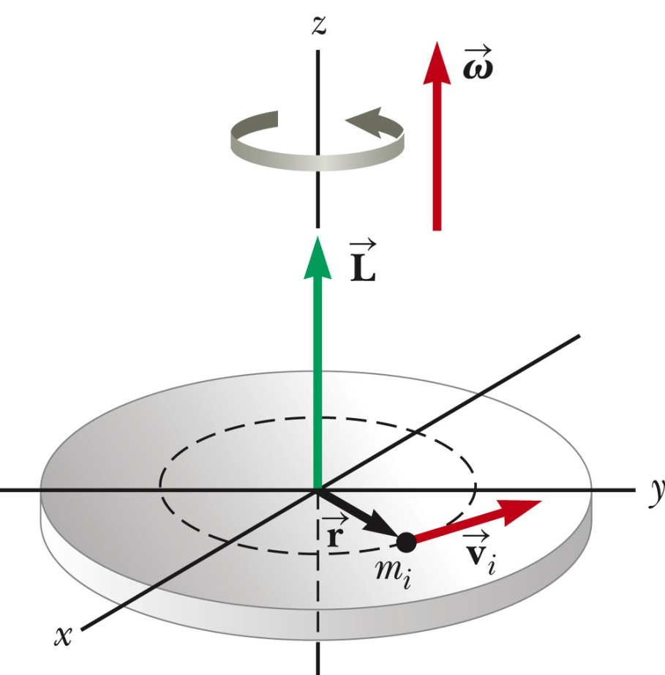
Angular Momentum of a Rotating Rigid Object
Consider an rigid object rotating along an axis with angular velocity .
To calculate the angular momentum of the rigid object, we divide it into many small particles.
The angular momentum of an individual particle is
and are directed along the z axis.
The total angular momentum of the rigid object is then:

Slide 20

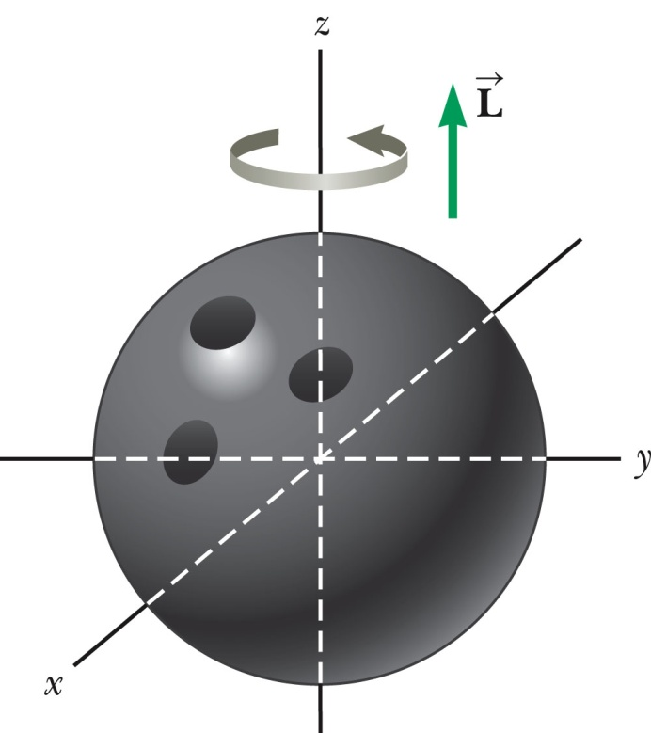
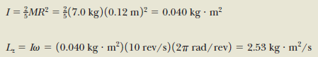
Estimate the magnitude of the angular momentum of a bowling ball with mass of 7.0 kg and a radius of 12 cm which is spinning at 10 rev/s as shown.

Slide 21
Conservation of Angular Momentum
Similar to the linear case with , we have conservation of linear
momentum ( ) when there is no net force acting on the system.
In angular case with , we have conservation of angular momentum ( )
when there is no net torque acting on the system.
is conserved if there is no net torque acting on the system.

Slide 22
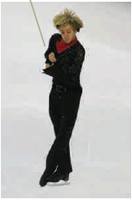
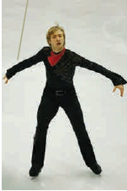
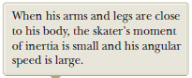
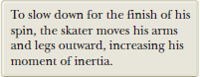
Conservation of Angular Momentum, cont
If the system is deformable such that the mass of the isolated system undergoes redistribution, the moment of inertia changes.
The conservation of angular momentum requires a compensating change in the angular velocity.
I_{i} ω_{i} = I_{f} ω_{f} = constant
This holds for rotation about a fixed axis and for rotation about an axis through the center of mass of a moving system.
The net torque must be zero in any case.

Slide 23
Conservation Law Summary
For an isolated system -
(1) Conservation of Energy:
E_{i} = E_{f}
If there is no energy transfers across the system boundary
(2) Conservation of Linear Momentum:
If the net external force on the system is zero
(3) Conservation of Angular Momentum:
If the net external torque on the system is zero

Slide 24
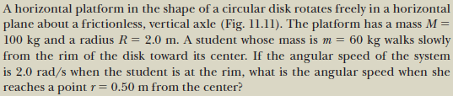
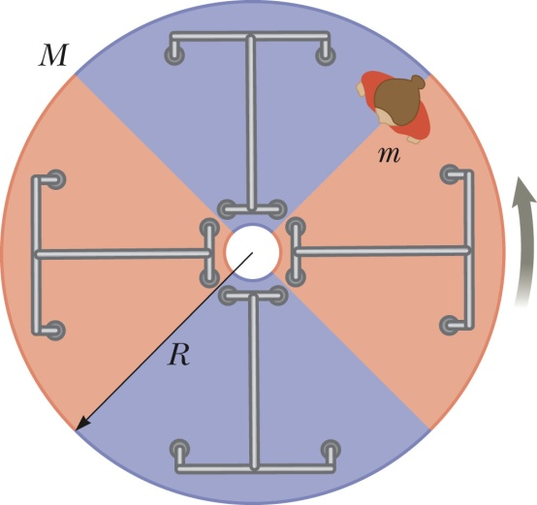
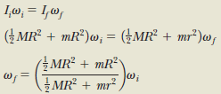
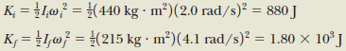

Slide 25
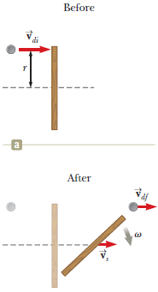
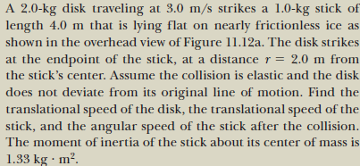
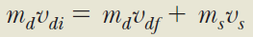
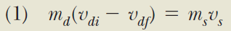
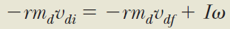
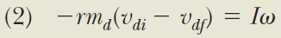
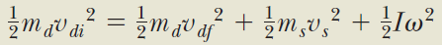
Conservation of linear momentum:
Conservation of angular momentum:
Conservation of energy:
Section 11.4

Slide 26
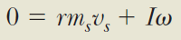
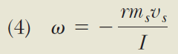
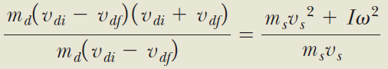
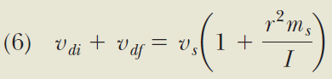

Slide 27






Slide 28


Slide 29


Summary

Slide 30

Summary
Summary

Slide 31
Static Equilibrium

Slide 32
Intended Learning Outcomes
To solve problems for a rigid body in static equilibrium

Slide 33
Static Equilibrium
Equilibrium implies that the object moves with both constant velocity and constant angular velocity relative to an observer in an inertial reference frame.
In this course, we will deal with the special case in which both of these velocities are equal to zero
This is called static equilibrium.
Static equilibrium is a common situation in engineering.
The principles involved are of particular interest to civil engineers, architects, and mechanical engineers.

Slide 34
Conditions for Equilibrium
The net external force on the object must equal zero.
The net external torque on the object about any axis must be zero.
These conditions describe the rigid object in equilibrium analysis model.

Slide 35
Equilibrium Equations
We will restrict the applications to situations in which all the forces lie in the xy plane.
These are called coplanar forces since they lie in the same plane.
This restriction results in three scalar equations.
There are three resulting equations:
ΣF_{x} = 0
ΣF_{y} = 0
Στ_{z} = 0
The location of the axis for the torque equation is arbitrary.

Slide 36


Slide 37






Slide 38







We have 3 unknowns, so we need 3 equations to solve them.
(3)

Slide 39







Slide 40










Slide 41


Slide 42






(A) Estimate the magnitude of the force F a person must apply to a wheelchair’s main wheel to roll up over a sidewalk curb. This main wheel that comes in contact with the curb has a radius r = 30 cm, and the height of the curb is h = 10 cm. Assume that the combined weight for the person and the wheelchair is mg = 1400 N.
Taking torques about an axis through A:
How large is this force?

Slide 43





Net force = 0

Slide 44

Summary

